Slide 1

Teaching Resources and Instructors’ Guidelines
Chapter 4: Developing an innovation strategy

Slide 2
Chapter 4: Developing an innovation strategy
In the following PowerPoint slides you will find the key headings from CHAPTER 4 together with the main illustrations, tables, etc.
There are also slides summarizing the key messages in bullet-point fashion, and a wide range of activities which you can use to help students explore around these themes.
Finally there are some reflection questions which can be used as the basis for discussion or assignments.

Slide 3
Learning objectives
By the end of this chapter you will understand:
The importance of innovation strategy as a framework to guide the process of change;
The three core elements of innovation strategy formulation:
  Strategic analysis – exploring where we could innovate;
  Strategic choice – choosing between different options;
  Strategic implementation – planning to make innovation happen;
The importance of dynamic capability and the role of innovation strategy in building this.

Slide 4

Core themes and material from the book

Slide 5

Why strategy?
Innovation is about change – but simply changing things randomly and in different directions is not likely to move the organization forward.
As the old saying has it, ‘if you don’t know where you are going, you’ll probably end up somewhere else!’.
So we need an innovation strategy, some kind of roadmap for guiding and shaping change and making sure we try and spend our limited resources as wisely as we can.

Slide 6
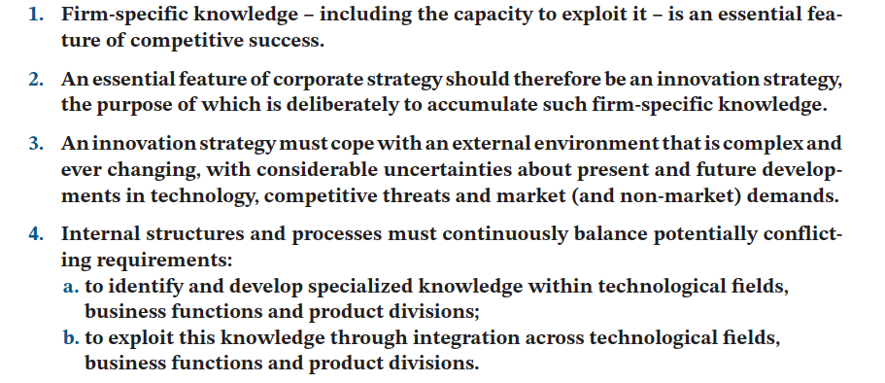
Why strategy?

Slide 7

Strategy as a roadmap for change
Innovation strategy provides a direction for change, helping the organization get towards where it wants to go. It may not be a simple ‘master plan’ or the realization of the entrepreneur’s initial Business Plan; more likely it will adapt and change over time.
But it is a guiding framework which helps focus and deploy limited resources in change projects that move the organization forward. That’s important if the organization is to survive and grow over time.

Slide 8
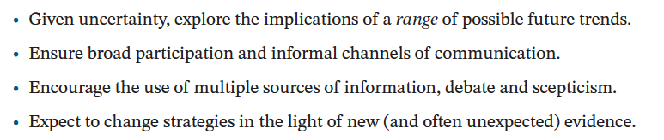
Key themes in making strategy

Slide 9
What’s in an innovation strategy?
  Strategic analysis – what could we do?
  Strategic selection – what are we going to do, and why?
  Strategic implementation – how are we going to make it happen?

Slide 10

Strategic analysis
  Where could we innovate?
  Why would it be worth doing so?
  Map the environment – technologies, competitors, markets, politics, etc.
  Opportunities and threats?
  Internal capabilities – strengths and weaknesses?

Slide 11
Exploring innovation space

Slide 12
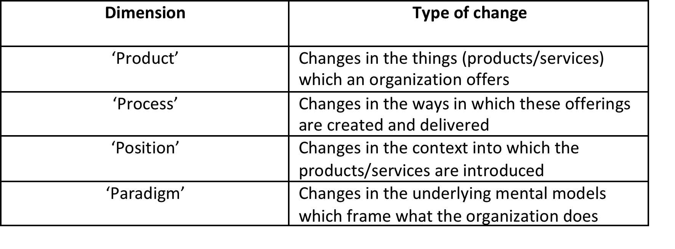
4Ps dimensions of innovation space

Slide 13
Strategic competencies
We need to consider that we don’t have completely free choice in innovation. We need to recognize that there is a degree of what is called ‘path dependency’ – what we accumulate by way of knowledge and other resources shapes what we can – and can’t -do. For example, if we see an opportunity for nuclear power as a new energy source this might be an interesting possibility – but pretty hard for us to achieve if we are in the business of ice cream selling! This ‘resource-based’ view looks from the inside out and suggests some of the ways in which we could deploy our particular strengths to advantage.

Slide 14
Diversity of strategic games for innovation
The MINE (Managing Innovation in the New Economy) research program at Ecole Polytechnique in Montreal, Canada, together with SPRU, University of Sussex, UK, conducted qualitative and quantitative studies to gain an understanding of the diversity of strategies for innovation. Almost 925 chief technology officers (CTOs) and senior managers of R&D (from Asia, North and South America, and Europe) across all industrial sectors of the economy responded to a global survey.

Slide 15
Diversity of strategic games for innovation (continued)
Each game is characterized by statistically different value-creation and -capture activities:
  Patent-driven discovery;
  Cost-based competition;
  Systems integration;
  Systems engineering and consulting;
  Platform orchestration;
  Customized mass-production;
  Innovation support and services.
Source: Miller, R. and S. Floricel (2007) Special Issue, International Journal of Innovation Management, 11 (1).

Slide 16
Strategic planning for implementation
The third stage in innovation strategy development is to plan for implementation. Thinking through what we are going to need and how we will get these resources, who we might need to partner with, what likely roadblocks might we find on the way – all of these questions feed into this step.

Slide 17

Communicating strategy
  Need to share and enable ‘buy in’;
  Need to break top level objectives down into manageable targets;
  Policy deployment.

Slide 18

Policy deployment
Use how/why charts as an activity to illustrate policy deployment

Slide 19
Dynamic capability
Dynamic capability is ‘appropriately adapting, integrating and re-configuring internal and external organizational skills, resources and functional competencies towards a changing environment’:
  competitive and national positions (technology and intellectual property, as well as its customer base and upstream relations with suppliers);
  technological paths (the strategic alternatives available to the firm, and the attractiveness of the opportunities which lie ahead);
  organizational and managerial processes (the set of routines which define ‘the way we do things around here’).

Slide 20
Summary
  Innovation involves uncertainty and risk and no one has infinite resources. So it makes sense to have a clear sense of direction and a framework within which to make decisions about the changes our organization will make.

Slide 21
Summary
  Innovation strategy is not about writing a document or report so much as having a framework for discussion and alignment.
  Innovation strategy is not a detailed plan and straight line journey so much as a flexible learning process.

Slide 22
Summary
  At the heart of an innovation strategy are 3 core questions:
    Analysis – what could we do?
    Selection – what are we going to do (and why)?
    Implementation – how are we going to do it?

Slide 23
Summary
There is a core role for leadership in innovation strategy to provide vision, direction and sometimes to stretch the organization in terms of its goals.
Innovation strategy needs to be shared and communicated so that everyone in the organization understands and can contribute.

Slide 24
Summary
  Innovation strategy is about building the capability to work in a complex and changing environment. So it is about building routines – capability – to make innovation happen, but it is also about being able to adapt and change those routines as the world shifts. This is ‘dynamic capability’.
  Dynamic capability involves working with the organization’s paths, processes and positions.

Slide 25

Videos
There are several videos which can help explore and present the key themes of the chapter:
Introduction to innovation strategy
Armin Rau talking about his experiences within Swisscom
Notes:
Short videos

Slide 26
Videos
Follow the link to watch Martin Reeve’s TED Talk on Strategy
https://www.ted.com/talks/martin_reeves_your_strategy_needs_a_strategy

Slide 27
Working with the 4Ps
The video of ‘Finnegan’s fish bar’ shows how you can use the model with a simple organization to explore innovation space. One activity is to get the class to watch it and then choose another simple example – a shop, a restaurant, etc. – and construct a 4Ps map of where and why it might innovate.

Slide 28
Videos
Follow this link to watch a video of John Bessant exploring the need for dynamic capability

Slide 29
Blogs and podcasts
There are several podcasts picking up key themes around managing innovation as a process and some of the key variables
You can also find a number of blog posts which pick up themes linked to strategy

Slide 30
Activities
There are a variety of activities (for both groups and individuals and for online as well as offline work. These include:

Slide 31

Game 1: Paper Planes
This is a simple interactive way to act as a good ‘icebreaker’ with students but also with innovation management generally as a course, helping to think holistically about challenges of innovation and its strategy
You can find details here

Slide 32
Activity 1: Strategy as a roadmap for change
There is an activity around trying to ‘reverse engineer’ innovation strategies
And some case examples can help explore this, for instance:
Marshalls
Aravind (strategy in social innovation)
Coloplast

Slide 33
Activity 2: Tools to help strategic analysis
Use the different tools to help construct a strategic map – one option is to break the class into groups and get each to use a different tool but working on the same organization. These different perspectives can then be combined into a composite map.

Slide 34
Activity: Working with the 4Ps
There is a video to begin to explore the model
And there is a detailed classroom activity suitable for group work

Slide 35

Video: The 4Ps approach
In this video John Bessant sets out the basic framework of the 4Ps and how it can be used to explore innovation space

Slide 36
Video: Using the 4Ps
The video of ‘Finnegan’s fish bar’ shows how you can use the model with a simple organisation to explore innovation space. One activity is to get the class to watch it and then choose another simple example – a shop, a restaurant, etc. – and construct a 4Ps map of where and why it might innovate.

Slide 37
Activity 4: Dragon’s Den
The Dragon’s Den activity helps explore this as a way of judging projects and there are plenty of live media examples of this approach to watch and discuss:

Slide 38
Activity 4: Dragon’s Den (continued)
Divide the class into investors and entrepreneurs.
Version 1. Give a specific innovative product that groups should present to investors working on their innovation strategy.
Version 2. Alternatively, ask students to work on an innovative product that they are interested in. Give them time in class or at home to work on an innovation strategy prior to presenting to Dragons. Ask the Dragons to prepare with questions in advance, too.

Slide 39
Activity 5: Competencies and capabilities
On the website there is a description of the tool – competency mapping – and an activity based on using this.

Slide 40
Activity 6: Strategic posture – how are we going to play the game?
Explain ideas around ‘first mover’, ‘fast follower’ and an activity might be to try and identify examples of different strategic postures taken by firms in the same industry.
Another activity is to try and use the strategic game framework described in the book and map an industry’s players on to that.

Slide 41
Activity 7: Around implementation planning
Strategic planning for implementation activity
Also try using the FMEA tool

Slide 42
Competencies
There are various case studies on the website which can highlight in class the role played by accumulated knowledge – for example 3M, Corning, Kodak, Fuji, Philips, Marshalls, etc.
An activity linked to these is to get students to try and explore the underlying competencies which such long-term businesses accumulate and how they deploy these. Other useful examples might be Honda (power transmission), Samsung (electronics), Rolls Royce (turbines and power) etc.
The detailed case of Tesco shows how a large retail organization builds competencies around market understanding – for example via its Clubcard.

Slide 43
Innovation strategy
Ask students to find a company whose experience they want to study. Using as an example the video of ‘Finnegan’s fish bar’, ask students to interview a company of their choice using 4Ps model.
Ask students to prepare a presentation or ideally a short video. As an element of competition among the groups, tell students that the best video might be send for the Innovation Portal.

Slide 44
Discussion 1: Why strategy?
A good place to start is to explore the different ways in which innovation can provide strategic advantage – and there is an activity to help do this either as an assignment or as a classroom discussion.
A variation on this is to ask about social innovation or innovation in the public sector – how does changing things here provide advantage?

Slide 45
Discussion 2: Strategic positioning
Key questions in this kind of approach are:
  What are the key competitive forces?
  What are the barriers to entry – can anyone come into the game or are most potential competitors kept out because of high costs, need for specialized knowledge, etc.?
  What is the likely threat from substitutes – different ways of delivering value in this game?
  What is the relative power of key players – customers, suppliers, regulators – and how can that shape the game?

Slide 46
Discussion 3: Three key questions
Of the routines which we have:
  Which should we do more of, enhance and develop?
  Which should we do less of, or even stop?
  Which new routines do we need to learn and embed to cope with new features of our innovation environment?

Slide 47
Cases
There are several case studies which highlight key themes in the chapter, including:
The Zara case demonstrates the contribution of dynamic capabilities to create a competitive advantage through process and product innovation.
• The Fujifilm case examines how the company responded to the major changes in the photographic industry as a consequence of the emergence of digital imaging
The Hella story shows how strategic management of innovation involves building both competence and capabilities over time

Slide 48
Tools
There are many useful tools to help with developing an innovation strategy – you can find them in the ‘Strategy toolkit’ section. They include:
4Ps mapping of innovation space
• Benchmarking
• Blue Ocean strategy
• Identifying innovative capabilities
• Portfolio management

Slide 49
Competitiveness profiling
Another way of exploring innovation space is to compare offerings or the ways in which they are crated and delivered. Where is there space to do something better than the competition? Where is there scope to do something completely different?
Competitiveness profiling is a simple tool and activity which can help explore this:
There is a short video explaining this tool here

Slide 50
Blue Ocean strategy
4Ps is a robust and simple approach but there are plenty of others – for example, Blue Ocean strategy has a good website and tools/examples which students could explore:

Slide 51

Tools 4: Strategic selection
The issue here is choosing out of all the things we could do which ones we will do – and why? We have scarce resources so we need to place our bets carefully, balancing the risks and rewards across a portfolio of projects. There are plenty of tools to help us do this – from simple financial measures like payback time or return on investment through to complex frameworks which compare projects across many dimensions.
There is a short video on this theme here

Slide 52
Tools 5: Exploring approaches to selection
The website has descriptions of a variety of tools to help with selection; a useful class activity is to take some of these – e.g. decision matrix – and apply it to a set of innovation opportunities:
You can find these in the Selection toolkit – for example
Decision matrix
Checklists

Slide 53
Tools 6: Portfolio methods
Portfolio techniques help with comparisons and evaluations across many dimensions. Perhaps the most famous is the Boston Box (market growth/share matrix) but there are many other versions using different axes to construct the matrix and explore options.
On the website there are descriptions of other selection tools and one set of activities is to get the class to try and apply these approaches to live examples of innovation opportunities.

Slide 54
Tools 7: Bubble charts
One useful version for such portfolio matrix approaches is the bubble chart which looks not only at factors like risk and reward but also explores the extent of investment/commitment involved. Placing small bets on higher risk projects is easier to justify when seen against the background of other project commitments.
There is a description of the tool on the website and an activity can be built around trying to map the portfolio of a company’s projects on a bubble chart:

Slide 55
Tools 8: Business cases
A much more detailed evaluation can be carried out by reading and exploring a well-constructed business case.
There is a description of building a business case on the website and also the Business model canvas tool which provides an alterative and dynamic framework for creating a case and engaging discussion round it:

Slide 56
Tools 1: To help strategic analysis
You can find these in the Strategy toolkit on the website
PEST analysis
Rich Pictures
SWOT analysis
Porter’s 5 forces

Slide 57
Tools/Activity: Competencies and capabilities
Follow the link for another approach to competency mapping suggested by Richard Hall. He distinguishes between intangible assets and intangible competencies. Assets include intellectual property rights and reputation. Competencies include the skills and know-how of employees, suppliers and distributors, and the collective attributes which constitute organizational culture.

Slide 58
Tools 9: To explore positioning
Michael Porter’s five forces is a simple but robust tool to explain innovation positioning
An activity based on using this tool:
Version 1: Select a company and ask students to analyse it using Michael Porter’s five forces.
Version 2: Ask students to analyse a company of their choice using Michael Porter’s five forces.

Slide 59
Tools 10: For implementation planning
You can find these in the Implementation toolkit on the website:
FMEA
Potential problem analysis
Scenarios
Business cases/canvas

Slide 60
Assessments
The following slides offer some example assessment questions and discussion themes for individual or group activity

Slide 61
Assessments
What is innovation strategy? What makes companies change their innovation strategy?
Present tools that can help with innovation strategy. Provide some illustrative examples.

Slide 62
Assessments
What determines innovation space? Why it matters? How companies can explore their innovation space. Ask to provide comparative examples.
Imagine Nick Smith has an innovative product idea. He is thinking of applying to investors (like in Dragon’s Den). What issues he has to be ready with preparing to present his idea to imaginable Dragons?

